Slide 1
Geometry Shaders
DirectX Day 4

Slide 2
The Pipeline: GS & SO
VRAM: Buffers, Constant Buffers, Textures. Read & Write.
Stream Output
Input Assembler
Vertex Shader
Hull Shader
Tessellator
Domain Shader
Geometry Shader
Rasterizer Stage
Pixel Shader
Output Merger

Slide 3
Geometry Shader Stage
The Geometry shader does not operate on individual vertices, instead it executes once for every primitive that will be created from those vertices.
This optional stage receives its topology from the vertex shader stage unless the optional tessellation stages have been activated.
The Geometry Shader has the ability to Append triangle, line or point data to a primitive.
A Geometry Shader can decide not to produce ANY primitives, thus allowing it to actually remove or filter geometry!
If you enable this Stage and expect to draw something, then know that it is right before the Rasterizer Stage and you must output Projected Vertex data(clip space) if you expect rasterization.

Slide 4
Stream Output Stage
Used to optionally capture processed geometric data. This data can then be used later on.
This stage is after the geometry shader but before the rasterizer.
Use it to store vertex data in a buffer (instead of/as well as) sending it to the rasterizer.
If the geometry shader is disabled the stream output stage can receive input directly from the vertex shader stage.
Buffers filled by the stream output stage can be consumed directly by the Input Assembler using the “ID3D11DeviceContext::DrawAuto” interface.

Slide 5
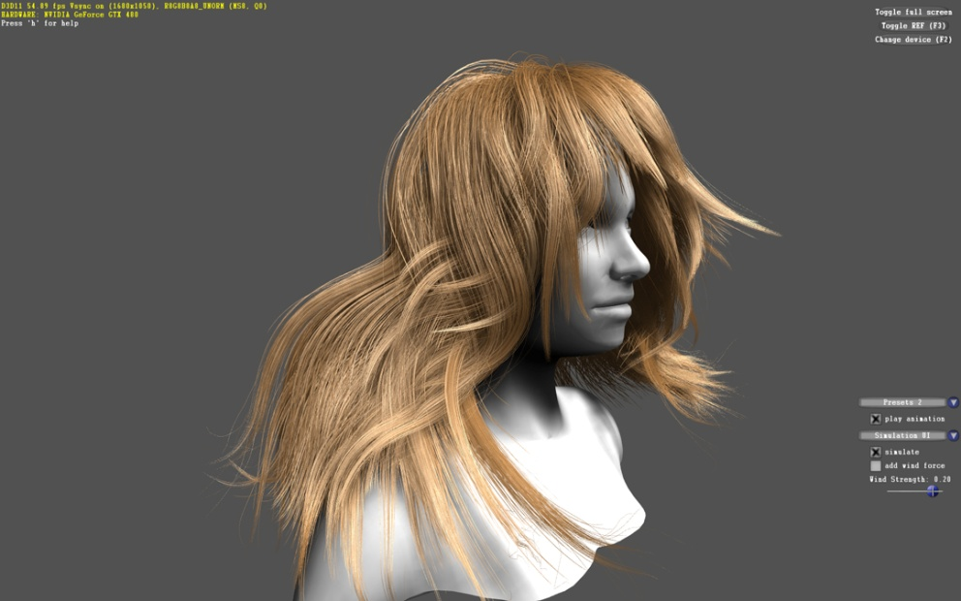
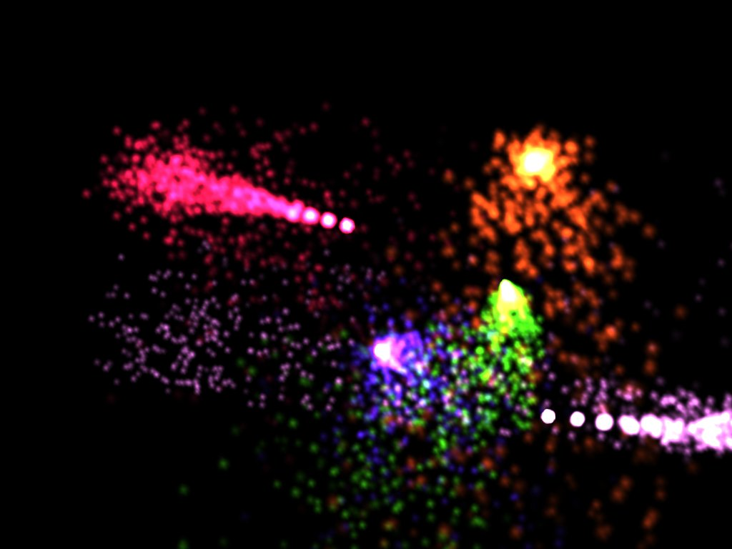
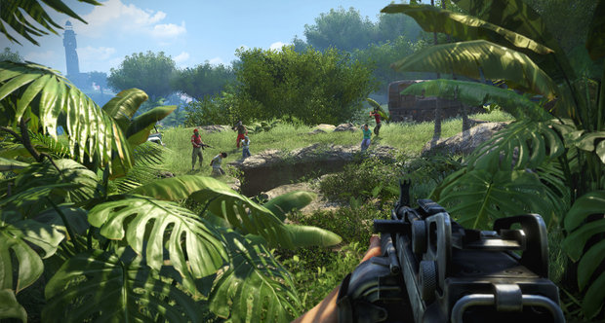


Geometry Shader Applications
HAIR
PARTICLES
FOLIAGE
FUR

Slide 6
Geometry Shader Continued
The Geometry Shader must output entire primitives.
The input primitive type need not match the output primitive type.
Triangle and Line output always takes the form of a STRIP. This is for efficiency reasons.
If you want output topology to not be interconnected you must use the “RestartStrip()” HLSL command.

Slide 7
Geometry Shader Example
// format of output verticies
// these could be going to the
// rasterizer the (SO)stage or both.
struct GSOutput
{
float4 color : COLOR;
float4 posH : SV_POSITION;
};
// convert each incoming world-space line segment into a projected triangle.
[maxvertexcount(3)] // max vertex data to be output (limit 1024 total scalars)
void main( line float4 input[2] : SV_POSITION, inout TriangleStream< GSOutput > output )
{
// red green and blue vertex
GSOutput verts[3] =
{
float4(1,0,0,1), float4(0,0,0,1),
float4(0,1,0,1), float4(0,0,0,1),
float4(0,0,1,1), float4(0,0,0,1)
};
// bottom left
verts[0].posH.xyz = input[0].xyz;
verts[0].posH.x -= 0.5f;
// bottom right
verts[2].posH = verts[0].posH;
verts[2].posH.x += 1.0f;
// top center
verts[1].posH.xyz = input[1].xyz;
// prep triangle for rasterization
float4x4 mVP = mul(mView,mProj);
for(uint i = 0; i < 3; ++i)
verts[i].posH = mul( verts[i].posH, mVP );
// send verts to the rasterizer
output.Append(verts[0]);
output.Append(verts[1]);
output.Append(verts[2]);
// do not connect to other triangles
output.RestartStrip();
}

Slide 8
Tips For Lab
A simple way to get to grips with the geometry shader is to send a large number of world space points down the pipeline and have the GS convert them all to triangles.
Use pencil and paper to help determine how to expand each primitive coming through the GS.
Be aware of things like polygon winding and what space you are working in.
Remember the GS is between the VS and RS stages.

Slide 9
Provided System Semantics
Many custom shaders can benefit from “pipeline provided” system semantics.
These semantics are automatically generated by the pipeline for use in shaders.
They are often used to identify what you are currently processing. This allows you to retrieve unique data from an SRV to fine tune your formulas.
Provided by the IA stage for use in later stages:
SV_VertexID (uint VS stage)
SV_InstanceID (uint VS stage)
SV_PrimitiveID (uint GS/PS stage)

Slide 10
Advanced Geometry Shaders
The GS itself has the ability to do instancing! This means you can make each input primitive run multiple times producing more complex output.
The GS has the ability to re-direct where a primitive will be rasterized if you have multiple render targets or even viewports! For example you could make a geometry shader draw to all six sides of a cube map at the same time!
Look up “SV_RenderTargetArrayIndex” and “SV_ViewportArrayIndex” to see how you can achieve this.

